Slide 1
MLDS 2018 Fall
HW4-3 - Actor-Critic
2018/12/21
adlxmlds@gmail.com

Slide 2
Outline
Outline
Environment
Actor-Critic
Grading & Format
  Grading Policy
  Code Format
  Report
  Submission

Slide 3
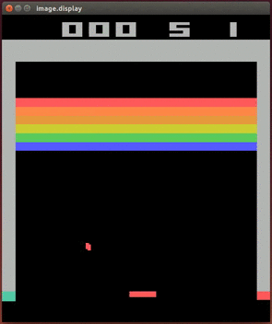
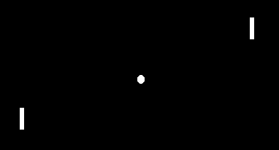
Environment
Introduction
Breakout
Pong

Slide 4
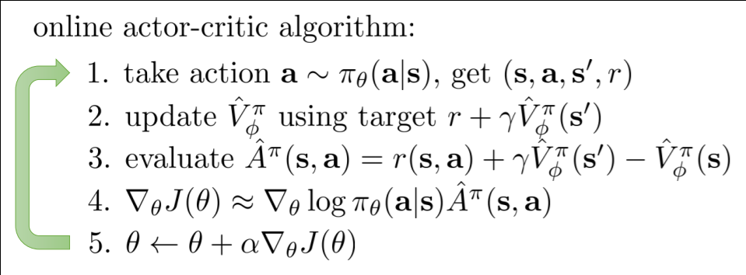
Actor Critic
Deep Reinforcement Learning
Notes:
單步更新 回合更新

Slide 5
Improvements to Actor-Critic
Deep Reinforcement Learning
DDPG : https://arxiv.org/abs/1509.02971
ACER : https://arxiv.org/pdf/1611.01224.pdf
A3C : https://arxiv.org/abs/1602.01783
A2C
ACKTR : https://arxiv.org/abs/1708.05144
PPO：https://arxiv.org/abs/1707.06347
Notes:
Ddpg=ac+dqn

Slide 6


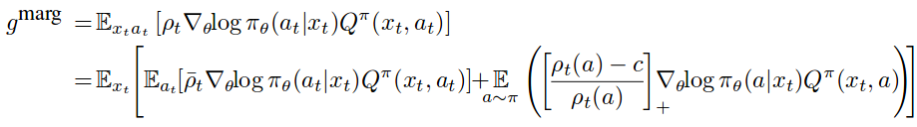
Sample Efficeint Actor-critic with Experience Replay
(ACER)
Deep Reinforcement Learning
Off policy → sample efficient, experience replay
How? → By importance sampling
Problem : High variance cause by ρ_t
  Use clipping → trade bias for variance
To correct bias, add a correction term

Slide 7
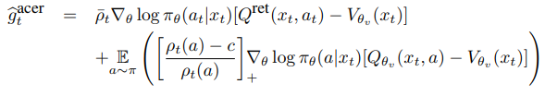
Sample Efficeint Actor-critic with Experience Replay
(ACER)
Deep Reinforcement Learning
How to evaluate Q^π under samples from μ?
  Use Retrace Estimator
  And loss gradient
Reduce variance by value function baseline yields

Slide 8
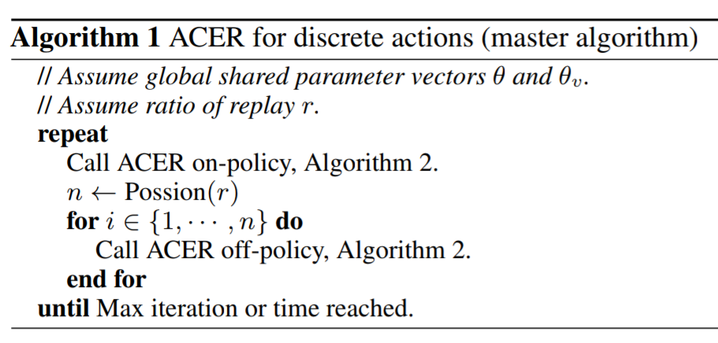
Algorithm (ACER)

Slide 9
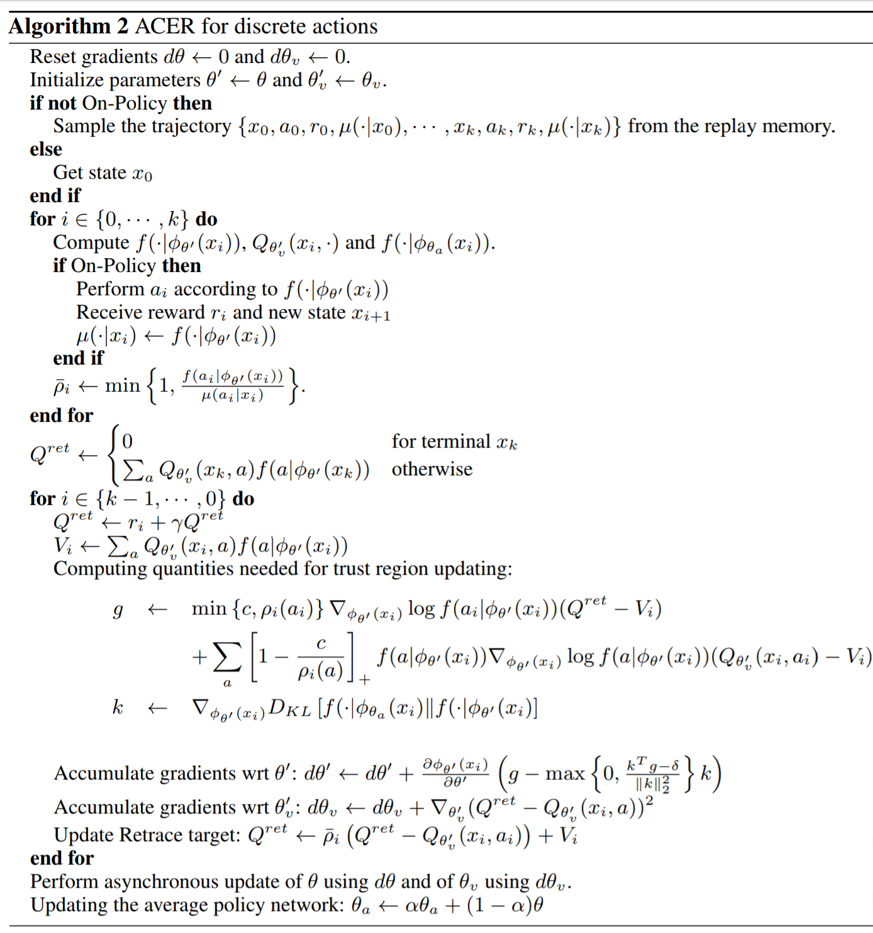
Algorithm (ACER)

Slide 10
Grading Policy
Grading & Format
Report

Slide 11
Report (6%)
Grading & Format
Up to 6 pages (4-1 + 4-2 + 4-3), in Chinese
Describe your actor-critic model on Pong and Breakout
Plot the learning curve and compare with 4-1 and 4-2 to show the performance of your actor-critic model on Pong & Breakout
  X-axis: number of time steps
  Y-axis: average reward in last 100 episodes
Reproduce 1 improvement method of actor-critic (Allow any resource)
  Describe the method
  Plot the learning curve and compare with 4-1 and 4-2, 4-3 to show the performance of your improvement

Slide 12
Related Materials
Course & Tutorial:
  Berkeley Deep Reinforcement Learning, Fall 2017
  David Silver RL course
  Nips 2016 RL tutorial
Blog:
  Andrej Karpathy’s blog
  Arthur Juliani’s Blog
Text Book:
  Reinforcement Learning: An Introduction
Repo:
  https://github.com/williamFalcon/DeepRLHacks

